Slide 1
The agile process
By Alex Frankel

Slide 2
Introduction
Within the world of Project Management there arose a necessity for a new more adaptable approach that would revolutionize the way we organize work forever!
This approach became known as AGILE.

Slide 3
What is Agile?
Originally, the traditional project management style, referred to as Waterfall, consisted of a rigid, linear sequence of developmental phases with little room for flexibility.
Agile, on the other hand, breaks down features of a product so that these phases can occur continually and independently of other features.
The fundamental unit of work in an Agile process is called a ‘sprint’. Agile, as opposed to the Waterfall methodology, consists of sprints of incremental features for a product in which planning, development, and testing all occur continually. This will be explained step-by-step later on.
Within Agile, there exist multiple variants of the methodology. One such variant is known as Scrum. Scrum deploys specific roles for a small development team.
The major difference between Agile and Scrum is that “Scrum is broken down into shorter sprints and smaller deliverables, while in Agile everything is delivered at the end of the project, “(Joubert, 2021).

Slide 4
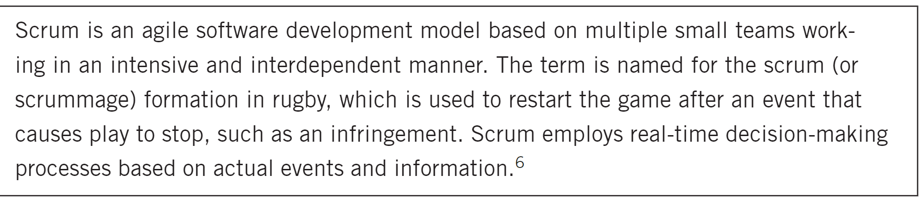
Definition of Agile
(Cobb, 2015)

Slide 5
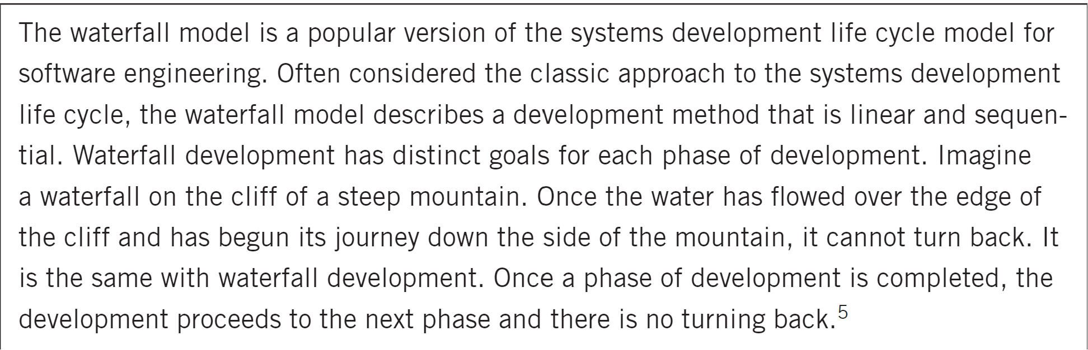
Definition of Waterfall
(Cobb, 2015)

Slide 6
The Scrum Team
SCRUM MASTER
Facilitate Scrum events
The Daily Scrum meeting
A short team meeting concerning daily progress, plans, and obstacles
Sprint Planning
An initial prioritization of features that will determine the sprint’s focus
Communicates with stakeholders outside the team
“The Scrum Master is a servant-leader for the Scrum Team. The Scrum Master helps those outside the Scrum Team understand which of their interactions with Scrum team are helpful and which aren’t,” (Cobb, 2015).
PRODUCT OWNER
“The Product Owner is responsible for maximizing the value of the product and the work of the Development Team,” (Cobb, 2015).
Translates stakeholder’s needs (user stories) for the team’s use
Manage and prioritize product backlog
Prioritizes what will be worked on within a sprint
Notifies the team of any updates or changes to this priority
Facilitates communication throughout the team and beyond
A Product Owner must keep the team up-to-date
DEVELOPMENT TEAM
(Developers and Testers)
“The responsibilities of a development team will also depend on the end goals of the Scrum Team”
“Help in Sprint planning and goal setting”
“Lend expertise to program, design, or improve products”
“Test products and prototypes, plus other forms of quality assurance”
(Coursera, 2023)
They do all the heavy lifting for the team- they are the ones who create the final product from the whole team’s organizational efforts.
“The Development Team consists of professionals who do the work of delivering a potentially releasable increment of “Done” product at the end of each Sprint,” (Cobb, 2015)
Definitions Provided By
(Coursera, 2023)

Slide 7
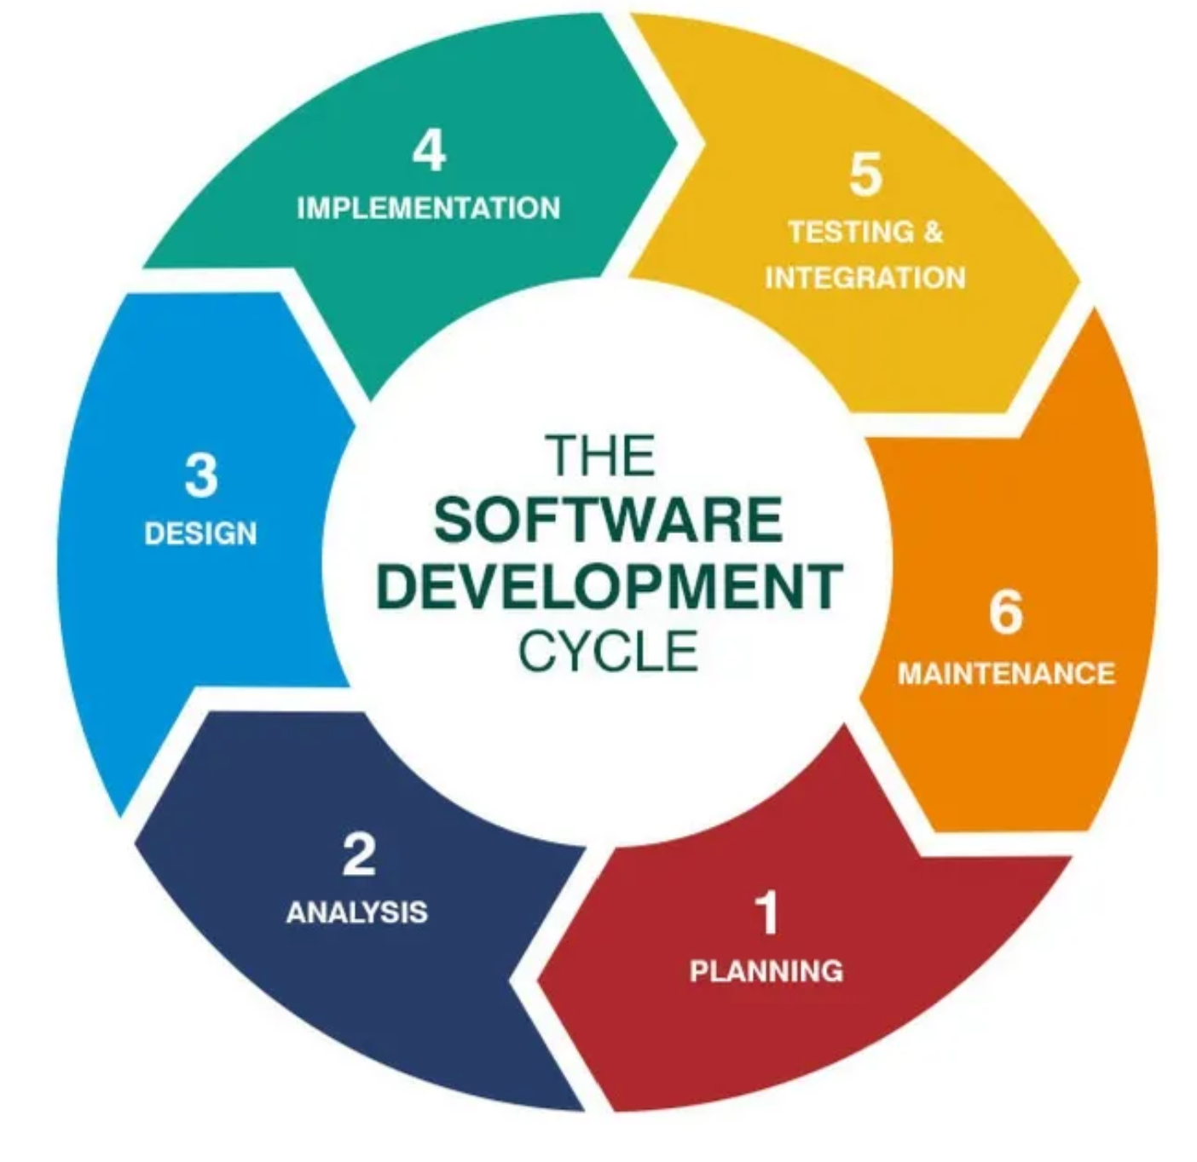
The Phases of Waterfall
The Software Development Life Cycle consists of 6 Major Phases- in Waterfall these are encountered linearly
Planning
“Meetings with managers, stake holders, and users are held in order to determine the requirements”
Analysis
“These requirements are analyzed for their validity and the possibility of incorporating the requirements in the system is also studied”
Design
“The system and software design is prepared from the requirement specifications”
Implementation
“The work is divided into modules/units (in this case, user stories and respective sprints) and actual coding is started”
In Agile, this refers to user stories and their respective sprints.
Testing & Integration
“After the code is developed it is tested against the requirements to make sure that the product is actually solving the needs addressed and gathered during the requirements phase”
At the end of each Sprint (in Scrum) “the product is deployed to the customer for their use”. In Agile, this may not occur until all sprints are completed
Maintenance
Products are never really ‘done’. Needs may arise in the future for quality-of-life updates or unforeseen problems may occur.
(Pinheiro, 2018)

Slide 8
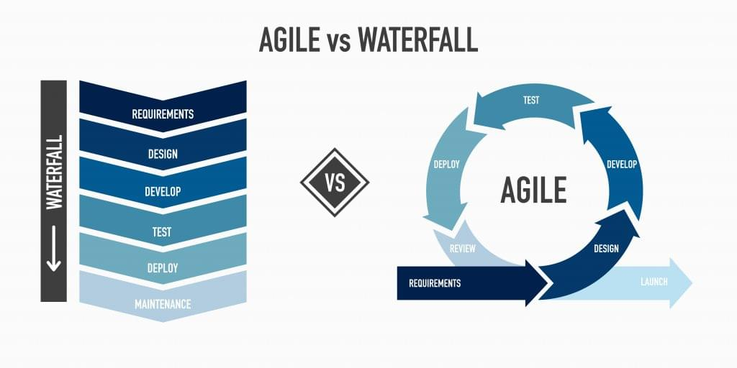
The Phases of Agile
Agile, on the other hand, revisits each these phases sequentially within each Sprint so that every feature is given equal treatment with room for change!
(Casucian, 2023)

Slide 9
Conclusion: Which should I use?
Project Management is a vast and varying subject matter. Waterfall and Agile are methodologies that need not be followed exactly as outlined. Aspects of both can be utilized in Software Development.
Generally, one must consider the following:
Waterfall is good to use when product knowledge is strong and you already have a good idea on the design of a project.
Unless all knowledge of a project is readily available starting out, you might opt for an Agile approach that allows room for uncertainty through error or changing needs. Otherwise, within a Waterfall approach, the project may need to be refactored entirely.

Slide 10
Works Cited
Charles G. Cobb. (2015). The Project Manager’s Guide to Mastering Agile : Principles and Practices for an Adaptive Approach. Wiley.
Joubert, S. (2021, April 25). Agile vs. Scrum: What’s the difference? Graduate Blog. https://graduate.northeastern.edu/resources/agile-vs-scrum/#:~:text=Scrum%20is%20broken%20down%20into,Scrum%20Master%20and%20Product%20Owner
The 3 scrum roles and responsibilities explained. Coursera. (n.d.-a). https://www.coursera.org/articles/scrum-roles-and-responsibilities
Pinheiro, J. (2018, April 12). Software development life cycle (SDLC) phases. Medium. https://medium.com/@jilvanpinheiro/software-development-life-cycle-sdlc-phases-40d46afbe384
Casucian, I. (2023, June 23). What is Agile Project Management?. TechnologyAdvice. https://technologyadvice.com/blog/information-technology/what-is-agile-project-management/

